Slide 1

Measure What Matters
Take your game to the next level, using data.
Notes:
INTRO SLIDE: needs a logo, and a better tag line.

Slide 2

TABLE OF CONTENTS
01
Project Background
02
Our Team
03
The Product
04
Experiences
05
Lessons Learned
Why do we need this product
Introduction to the MWM team
Highlights of the delivered product
Ups and Downs of the project
Things we would do differently

Slide 3

Project Background
Collecting stats by hand is inefficient and limits data collection ability
Create a simple UI to make stats collection easier
Assist coach in making decisions using detailed statistical reports
Extendability and reliability

Slide 4




Ayub (‘Jack of all trades’) Ahmed
Frontend
Backend

Slide 5


Bard (‘I’ll do it’) Samimi
Backend

Slide 6


Chloe Shang
Frontend

Slide 7

Taylor (‘who’s on meeting minutes’) Zowtuk
Frontend

Slide 8



Joe (‘just Joe’) Potentier-Neal
Backend
Architecture
Database Design
Deployment

Slide 9
Experiences
Sprint 1
Sprint 2
Sprint 3
Sprint 4
Planning went well, and all parts were completed
Trouble was realizing the most efficient path forward
Completed all must haves
Took on too many user stories for one sprint
Chose technologies that were new to some members, slowing down progress
Finish what was missed in Sprint 2
Rebalanced team to have more front end developers
More game events
More reports
Cleaned up UI
Better error handling
End-to-end testing
Deployed
Documentation

Slide 10
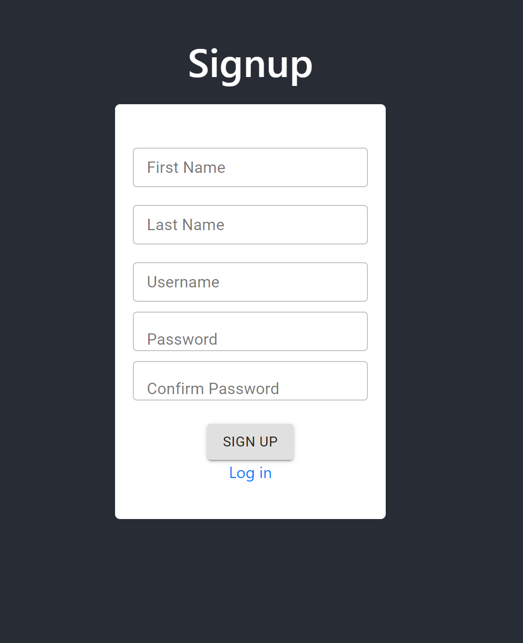
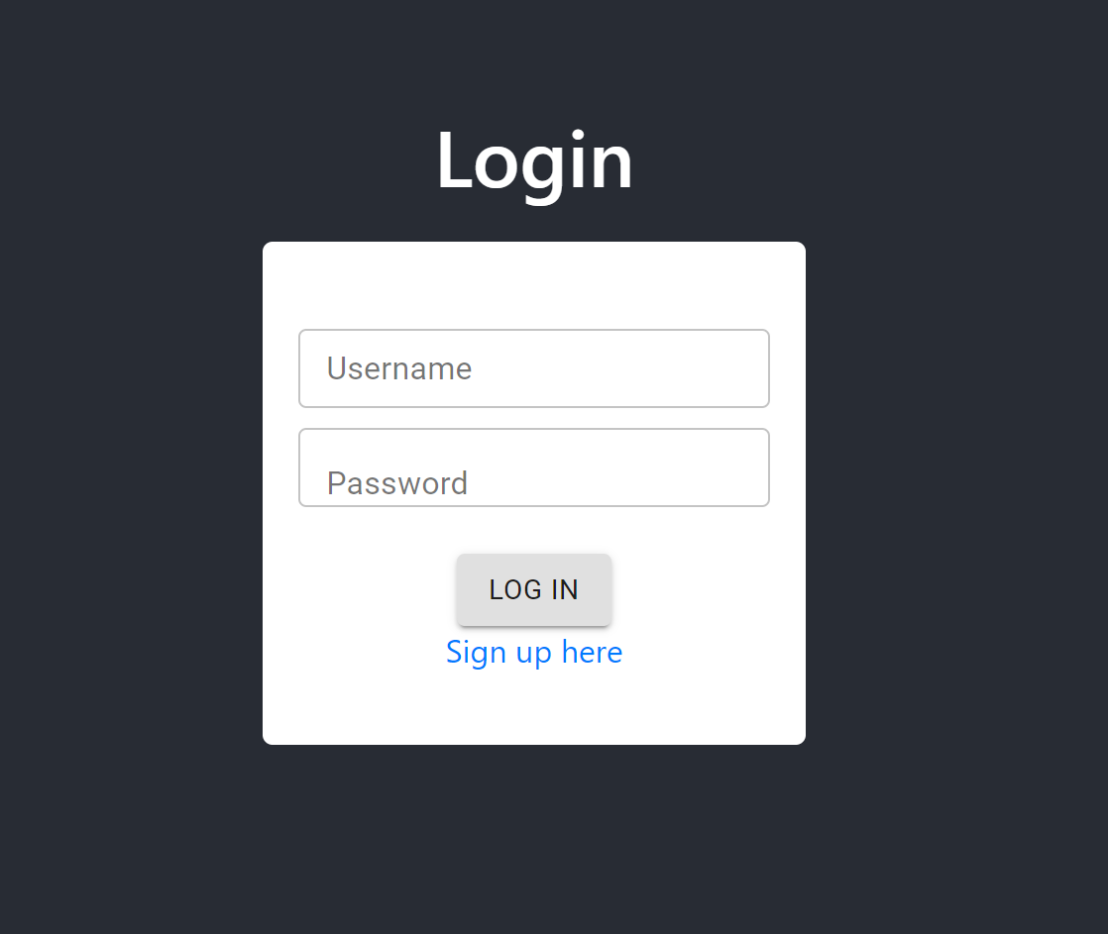
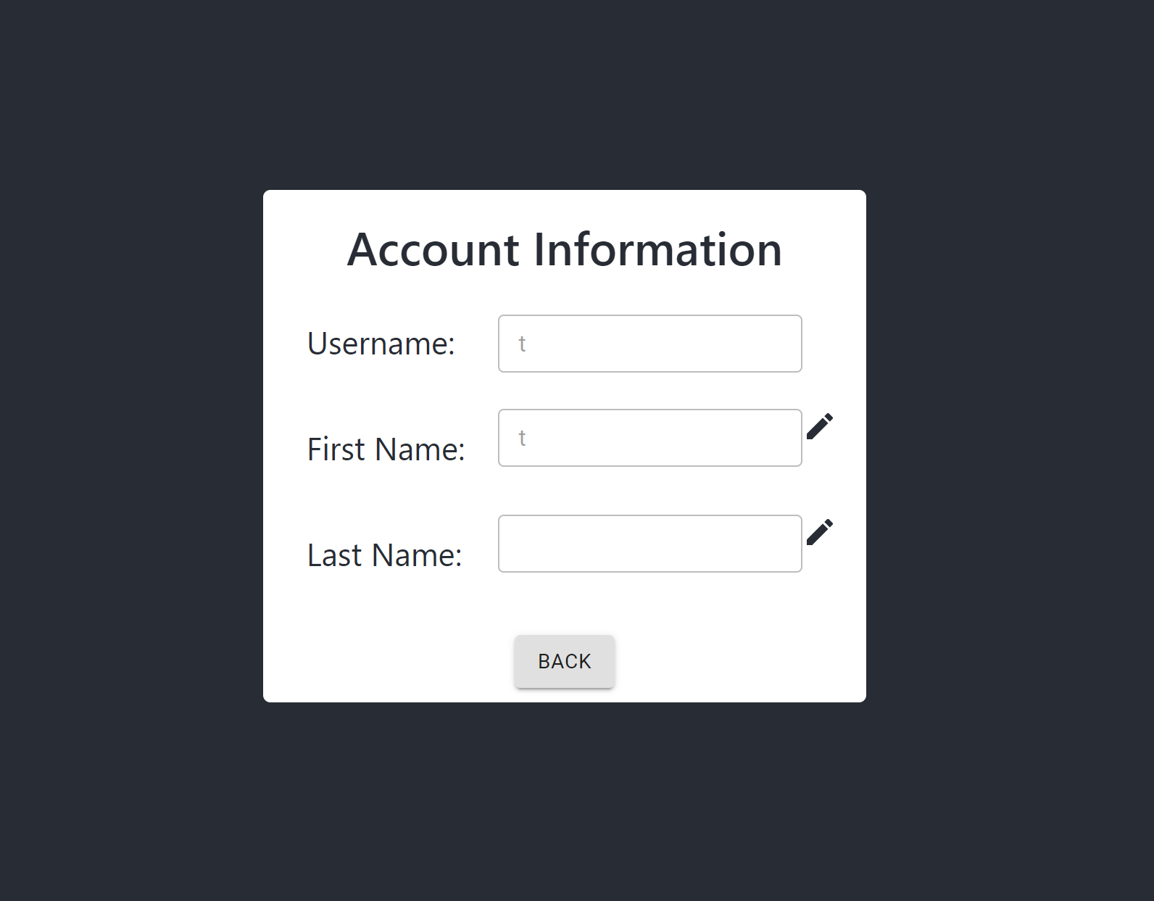
Account Functionalities

Slide 11
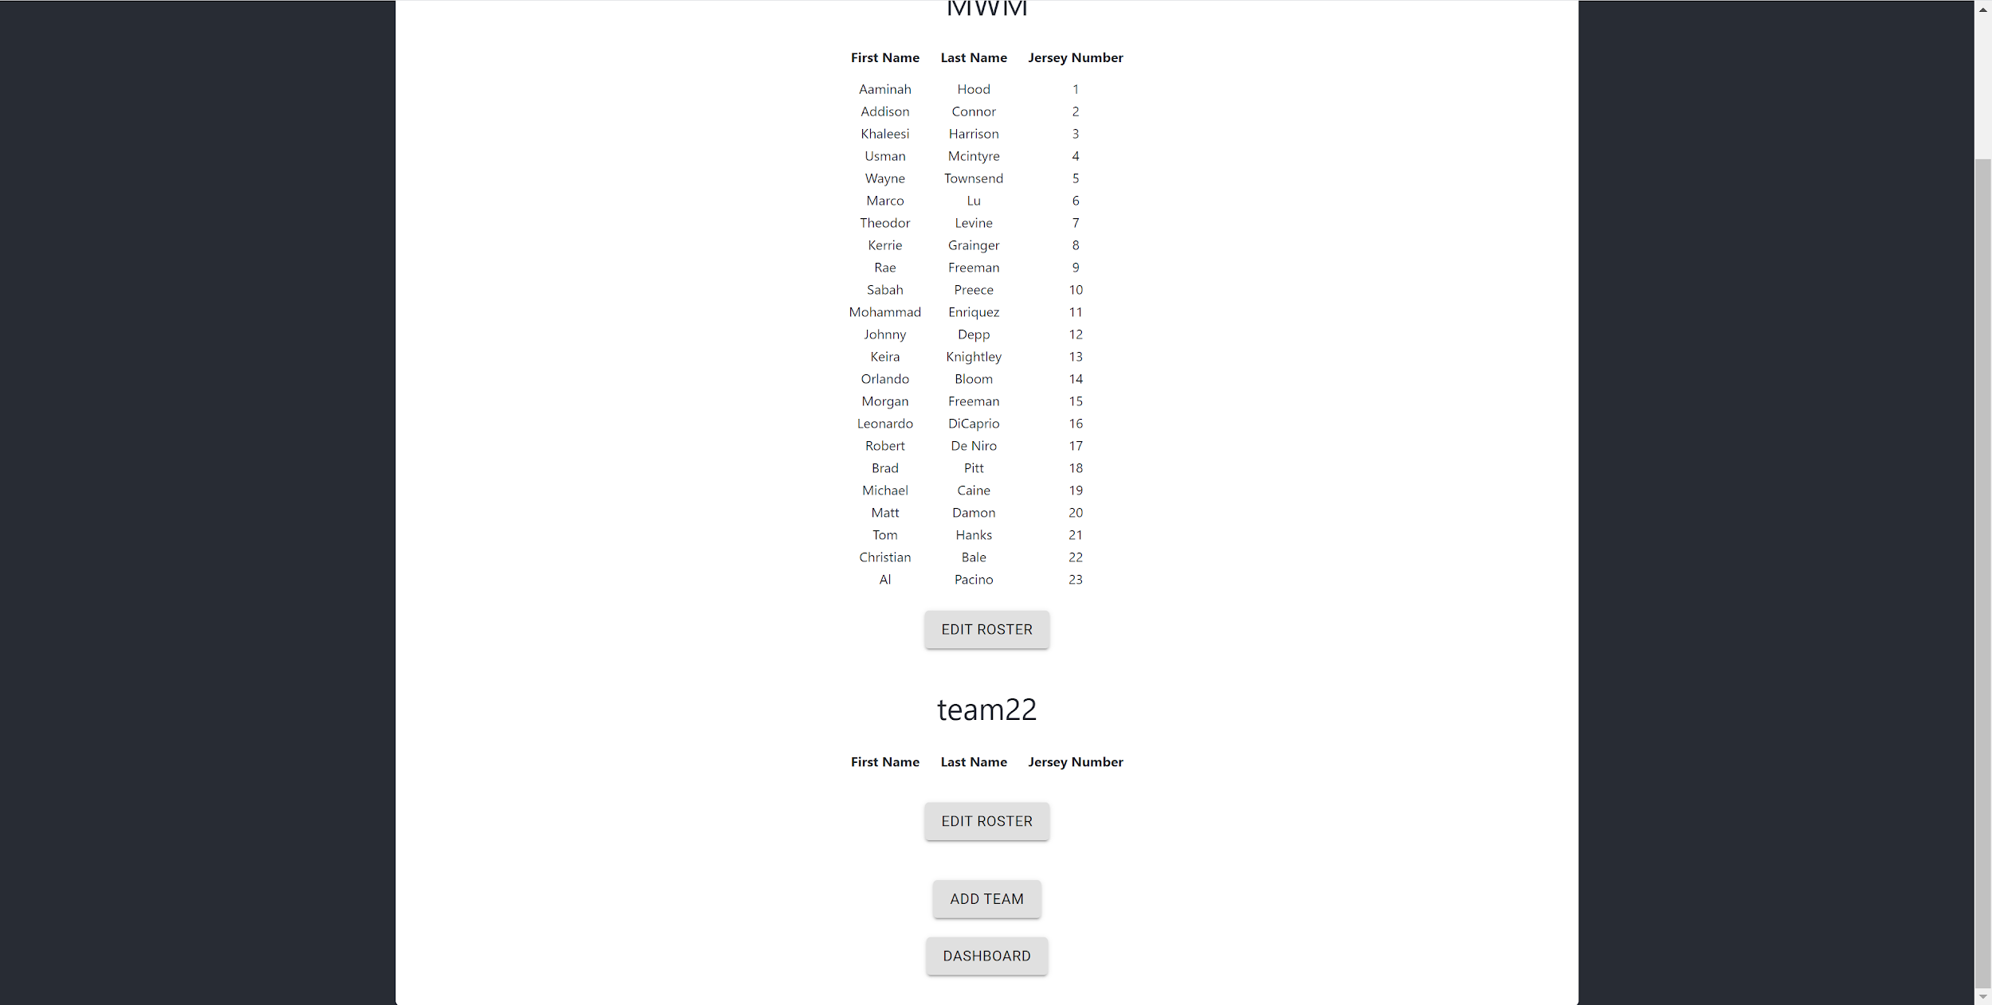
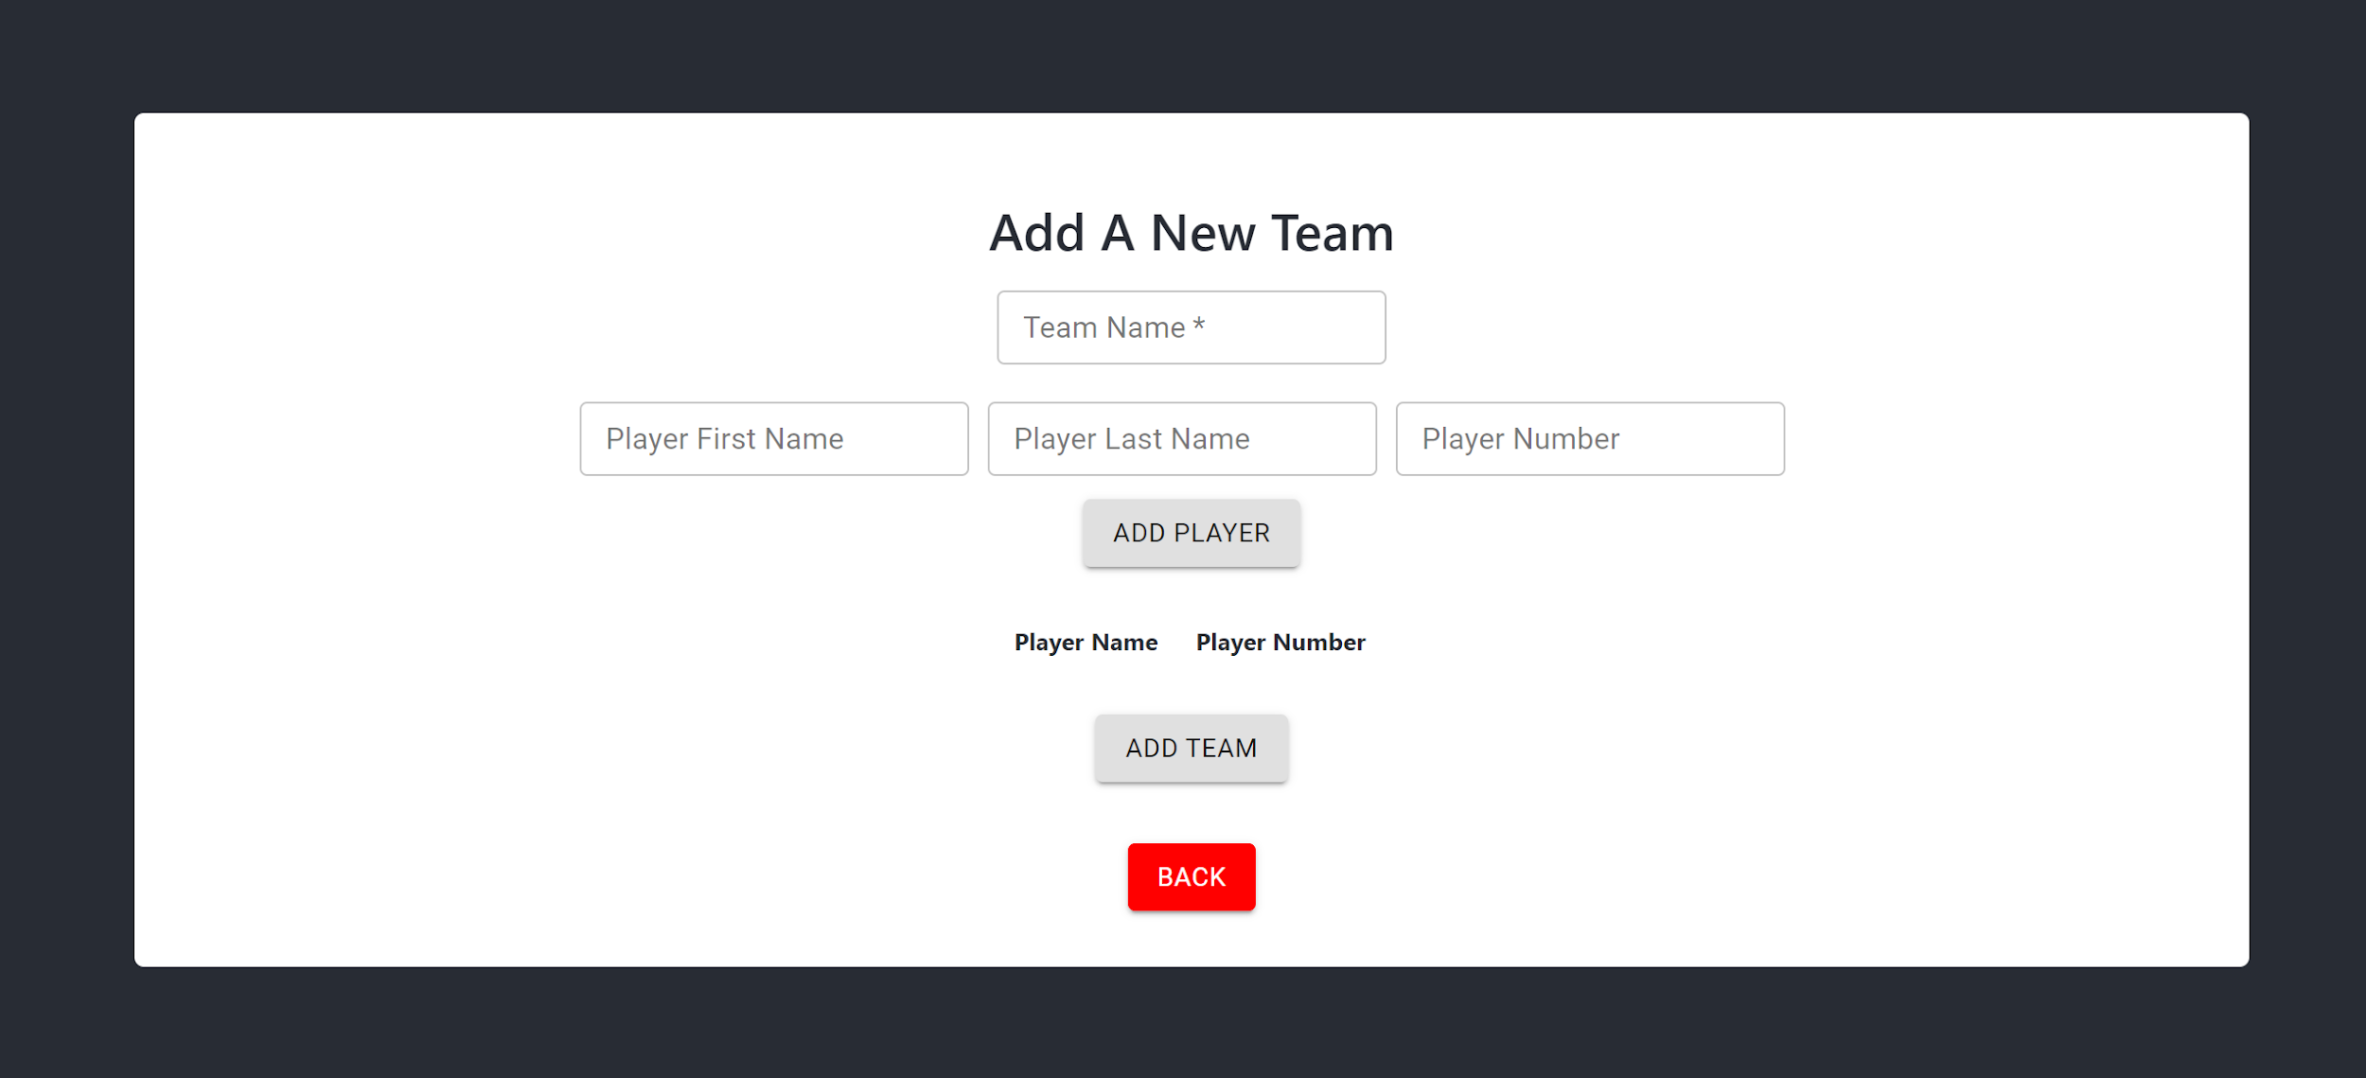
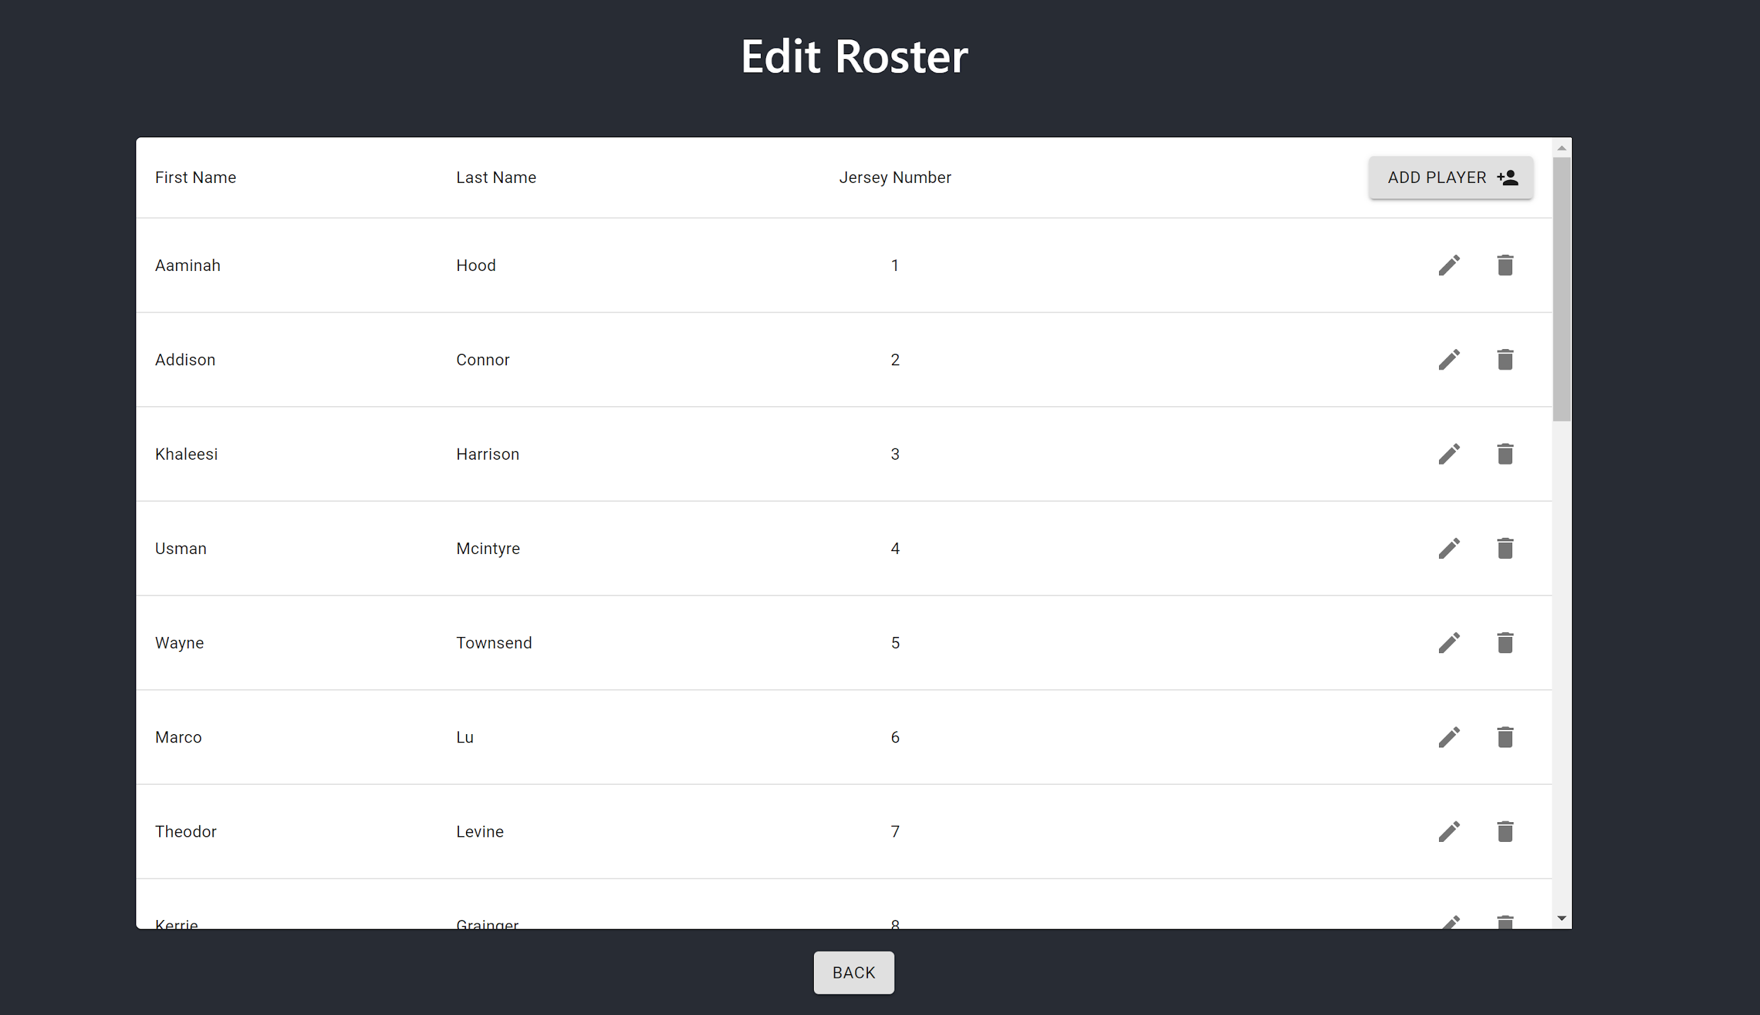
Team Functionalities

Slide 12
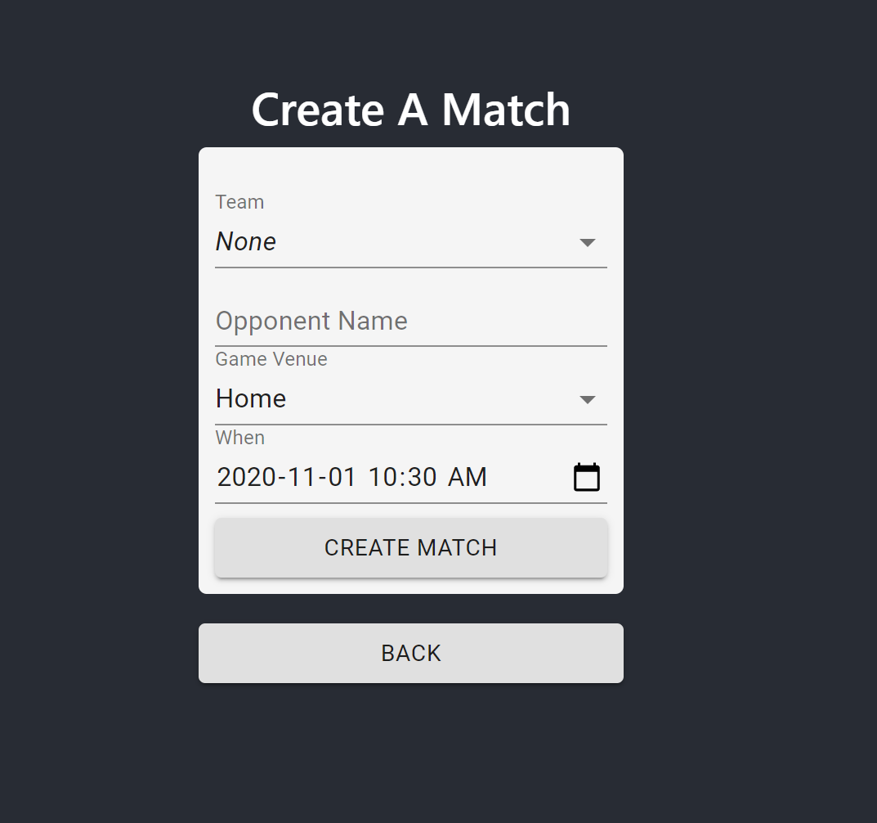
Match Creation

Slide 13
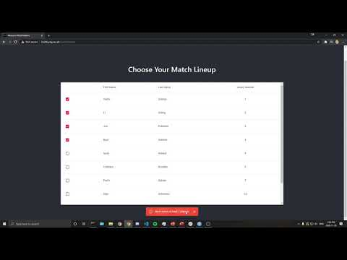
Recording Screen
https://www.youtube.com/watch?v=Z0JGxdxM1kk

Slide 14
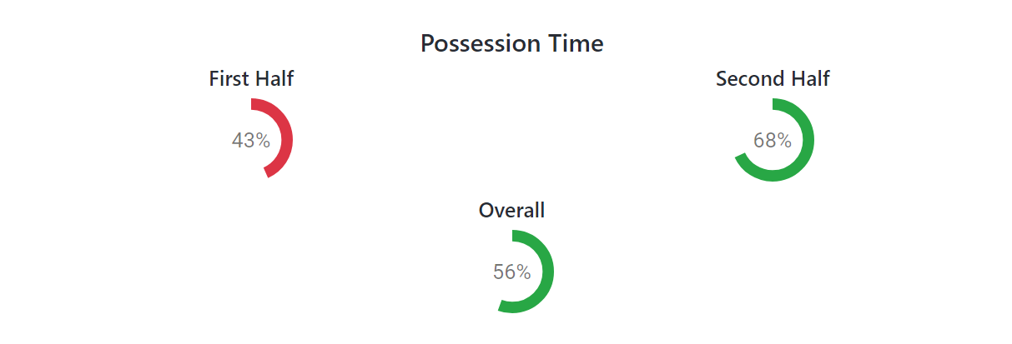
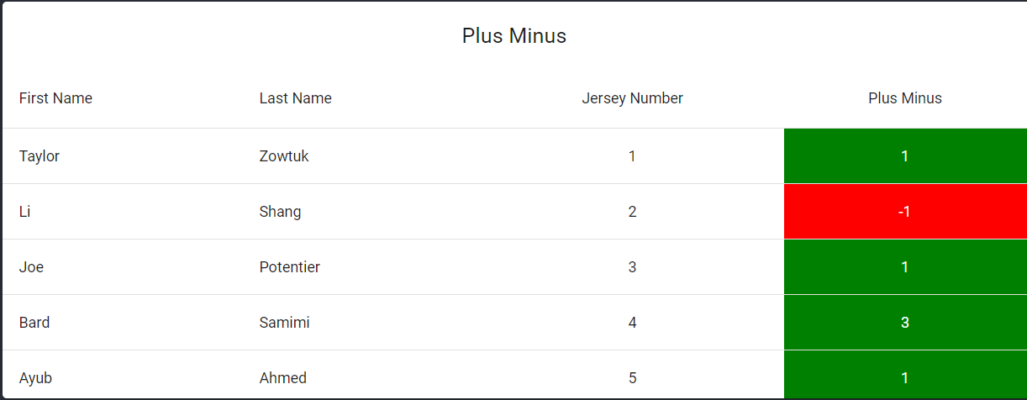
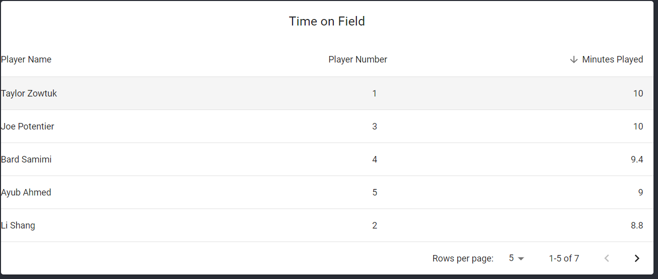
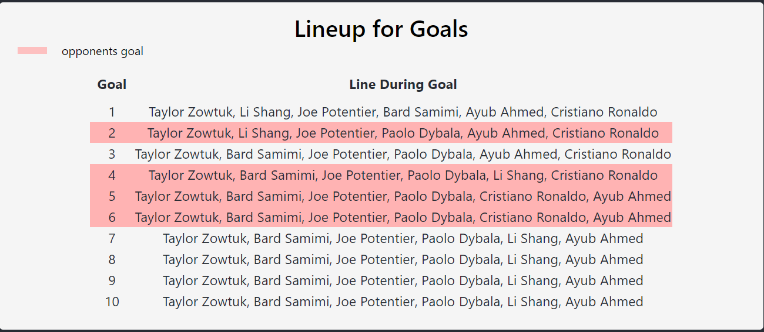
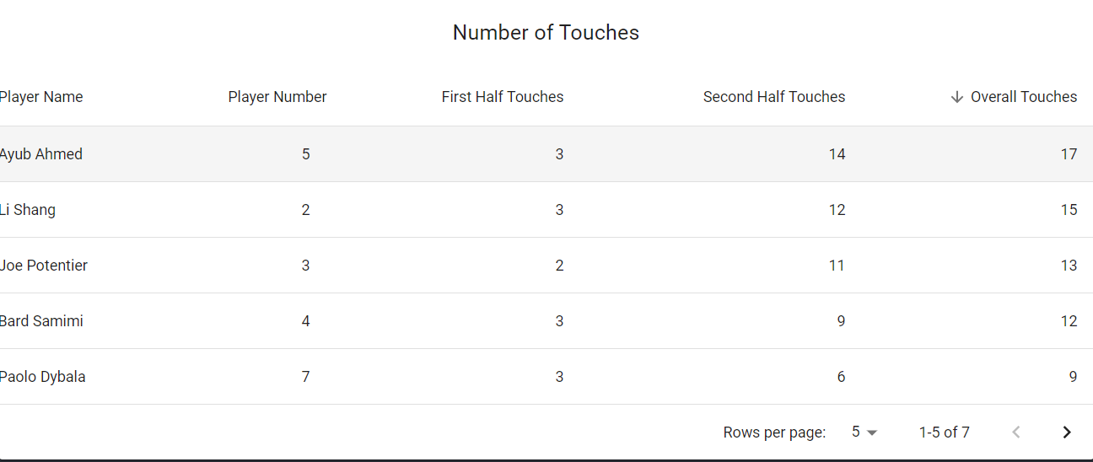
Reports

Slide 15
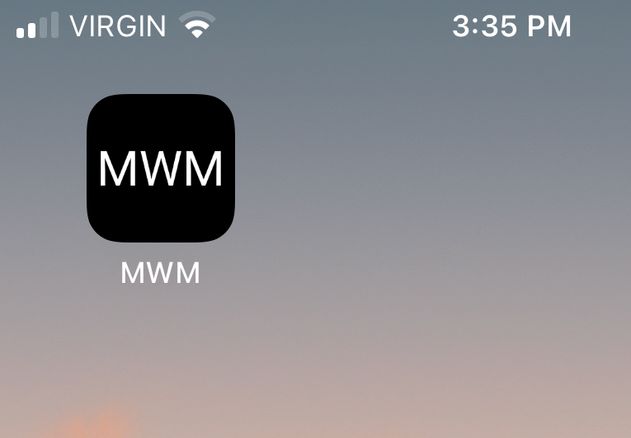


Frontend
Single-page application
Responsive design (from mobile to desktop)
Progressive Web App
Offline functionality via caching
Drag and drop
Notes:
Uses the React library for UI rendering written in Typescript
PWA: Installable enabling App or Browser experiences
Local Storage in the browser is used to cache events, in order to allow offline functionality
Draggables are created using React DnD (Drag and Drop for React) library

Slide 16

Backend + Data Layer
Uses NodeJs 14
The NestJS API framework
Typeorm
PostgreSQL Database
PM2 Process Manager
Notes:
Uses NodeJs 14 which enables Javascript to be run outside of the browser and as a server
The NestJS API framework, which gives a predefined structural definition to writing many types of APIs. We make use of the modular structure to organize functionality. It also uses dependency injection by default, which makes testing relatively simple.
Typeorm, abstracts the data layer away from the back end services. We use entity definitions to create tables based on objects in javascript. Typeorm generates migrations which allows flexibility in the database.
A PostgreSQL database launched from Docker. The docker image takes care of all the required software needed to run Postgres.
The data is stored in an external directory and the docker container is mounted to that directory on creation.
Postgres is a relational database, which allows for easy querying of data that relates to each other.

Slide 17
Lessons Learned
Estimation
Break Down User Stories
Overestimated amount of tasks that we could complete in a single sprint
Realized gaps in the app well into development

Slide 18
Questions?
Measure What Matters
Take your game to the next level, using data.

